Slide 1

Trade off between the Liberalism and the Neo-liberalism
Submitted to
Dr. Shanthie M. Dsouza
Founding Faculty – International Relations
KSPP
Shankar Mepparambath

Slide 2
Liberalism and Neo-Liberalism
Berlin's and Raz’s - ”Perfectionist liberalism", perfectionist encompassed doctrine about the good life and the nature of value
Ronald Dworkin - “Comprehensive liberalism” may be a non-perfectionist, defended the ideal of state neutrality
Charles Larmore - ”Political liberalism" recommends resolving the disagreements in a pluralistic society, where individual freedom and equal rights of citizens are rooted in the public political culture of liberal democracy
Dürkheim and Caillois - “Neo-liberalism” tangent deviated more emphasizing the economic development of states though its origin is more social development through entrepreneurship and competitiveness.

Slide 3
Literature on Liberalism and Neo-Lib.
liberalism is emphasized on considerable values, principles about political rights, civil liberties, and promoting the shared cooperation for the benefit of universalism
neo-liberalism is backing the contemporary imperialism which binds all the economic institutions and various business activities and occupying the role of in terms of employment opportunities and influencing the state regulations on the business
(Girdwood 2007) highlights the reforms needed in the world bank. It moved from social-liberalism to neo-liberalism, especially education for the government in neo-liberal styles.
(Gane 2009) asserted that, originally philosophers thought that neo-liberalism was a new stage of socialism, but it might be called "negative socialism"
Hoffman defined "the neo-liberal agenda as broad, encompassing and extremely divisive in terms of the centre and the periphery".

Slide 4
Research GAP
Many past studies attempted to relate both liberalism and neo-liberalism in theoretical and philosophical approaches; however, their dearth of study operationalized both the constructs and established the quantitative relationship backed by statistics.
Study limitation
Limited only to two theoretical perspectives and other are not touched
Operationalized through proxy than actual indicators
Indicators are borrowed from the existing index than generated by the researcher
Study period restricted only to 2015 to 2019
This study used dimensions of freedom index as the variables measuring the concepts of liberalism and trade dimensions of economic freedom index variables used as measuring neo-liberalism.

Slide 5
Research Questions and Hypothesis
Does liberalism (Political rights and civil liberties) affect the presence of neo-liberalism (Tariffs, Non-tariff trade barriers, Financial Openness and Freedom to trade internationally) among the regions?
Have any statistical differences on liberalism and neo-liberalism on regions wise. (Europe, MENA, SSA, Americas, Eurasia, and Asia).
H1A: There is a relationship between liberalism (Political rights and civil liberties) and neo-liberalism (Tariffs, Non-tariff trade barriers, Financial Openness and Freedom to trade internationally) among the various regions.
H2A: Disparity in the presence of liberalism and neo-liberalism across the region-wise (Europe, MENA, SSA, Americas, Eurasia, and Asia)

Slide 6
Research Methodology
positivism paradigm
Analytical research method
using quantitative-based analytical method.
Statistical application
The formulated hypothesis is tested using statistical techniques like correlation, regression and one way ANOVA test.
The data is collected from the Fraser Institute website for Economic freedom (EF) index, and Freedom Index (FF) is collected from the Freedom House website

Slide 7
Measured used in the study
Freedom Index has two dimensions, namely 1. Political rights and 2. civil liberties used proxy for liberalism
The aggregated score of Political Rights is ranged between 0–40, and its aggregated score of Civil Liberties is ranged between 0–60
The study was interested only in exploring the Regulatory efficiency; the study selected four indicators that measure the international business of system of both Tariff and non-tariff. These four variables are used as a proxy to measure neo-liberalism

Slide 8
Data Analysis
Empirical Implications of Theoretical Models (EITM) approach suggested by (Box-Steffensmeier, Brady, and Collier 2008, 828–43), which emphasized leveraging the theory with the support of empirical evidence and establishing causal mechanism using data.
ANOVA used to test (H2)
Multiple regression used to test (H1)

Slide 9
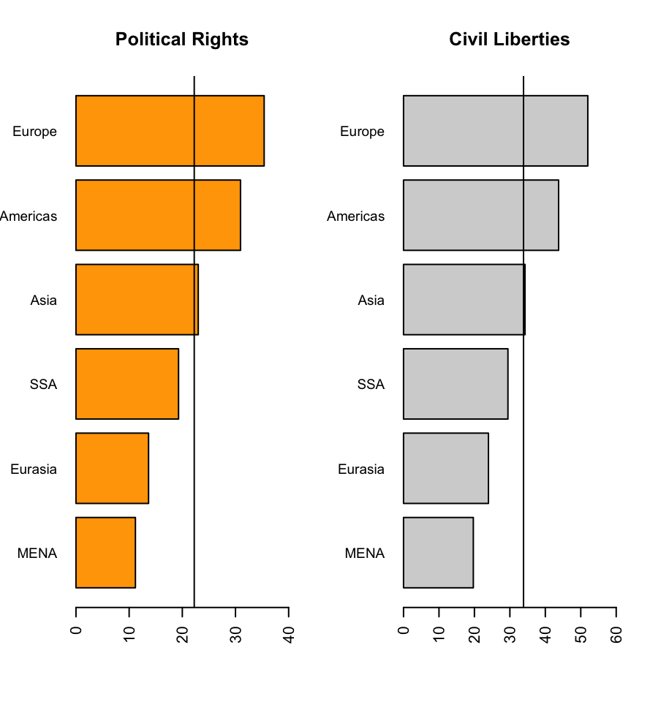
ANOVA Results
Both Political rights and civil liberties have the same pattern, European regions scored the highest average, PR M=35.39 +/-(5.77) and CL, M=51.99 +/-(8.33), in both cases, F value is statistically significant and P <.001, the output showed hypotheses two confirm the theory of liberalism values persisting higher in Europe region compared to another region of the world

Slide 10
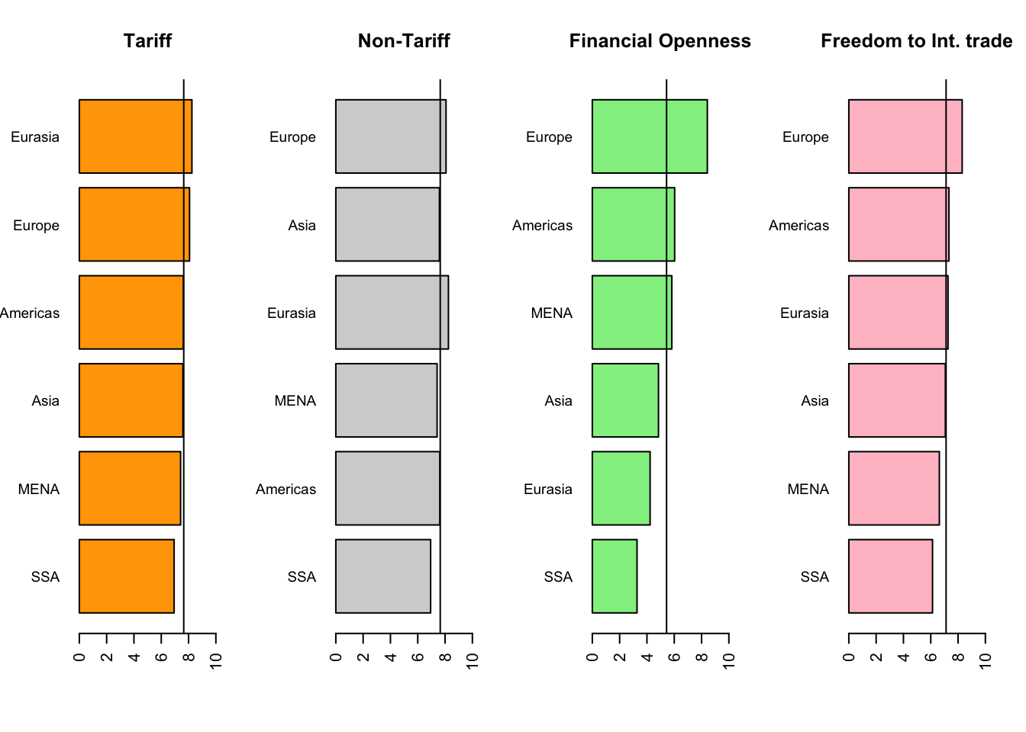
ANOVA Results
All the four indicators are measuring neo-liberalism; on Tariff, Eurasia is dominating M=8.25 out of 10 and Sd = +/- .69, F = 247.97 and P < .001. Non-tariff trade barriers, Financial Openness, and Freedom to trade internationally, Europe is secured higher scored than other regions, and all the P values <.001, it showed. Hypotheses 2 confirmed that the theory of neoliberalism is prevailing higher in the European region than in other parts of the world.

Slide 11
Regression Results
==========================================
Dependent variable:
--------------------------------------------------
M1= Tariffs M2 = Non Tariff
trade barriers
--------------------------------------------------------------------------
Constant 6.978*** 4.326***
(0.149) (0.128)
Reference(America)
RegionAsia 0.131 0.510***
(0.113) (0.096)
RegionEurasia 0.818*** 0.419***
(0.163) (0.139)
RegionEurope 0.350*** 0.500***
(0.105) (0.089)
RegionMENA 0.124 0.737***
(0.142) (0.121)
RegionSSA -0.466*** -0.089
(0.108) (0.092)
Political_Rights -0.008 -0.031***
(0.009) (0.007)
Civil_Liberties 0.020*** 0.049***
(0.007) (0.006)
-----------------------------------------------------------------------------
Observations 1,069 1,061
R2 0.165 0.261
Adjusted R2 0.159 0.256
Residual S.E. 1.037 (df = 1061) 0.883 (df = 1053)
F Statistic 29.911*** (df = 7; 1061) 53.025*** (df = 7; 1053)
================================================
Model 1 & 2
R square are 0.165 and 0.261, respectively. R square is ranged between 0 to 1; the higher the R square better the explanatory power.
In model 1&2, political rights are not established statistical significant with DV. However, it attained an expected negative relationship. Hence overall Analysis supported Hypothesis 1
In model 1&2, Civil liberties are established statistical significant with DV.

Slide 12
Regression Results
Model 3 & 4
R square are .330 and 0.461, respectively.
In model 3&4, political rights are established statistical significant with DV. and, it attained an expected negative relationship. Hence overall Analysis supported Hypothesis 1
In model 3&4, Civil liberties are established statistical significant with DV.

Slide 13
Findings and conclusions
Study findings revealed, the political rights have a negative relationship with all the four indicators of neo-liberalism, this explaining that, when an increase in political rights, neo-liberalism declines.
Prior studies such as (Gane 2009), (Girdwood 2007) and (NIXON 2012) conceptually supported the findings of the current study
trade-off between political rights and the economic empowerment of the state
civil liberties are positively related to all four indicators, study findings reemphasized of the previous study neo-liberalism is very much manifested through financial openness and Freedom trade internationally compared with Tariff and non-tariff barriers.
Region-wise, MENA and SSA need more improvement in all the indicators, on Tariff and Non-Tariff, Asia improving gradually.
the study gave a warning message to policymakers not to stretch neo-liberalism beyond the saddle point where it disturb the fundamental rights of the political institutions.
The world order is very much influenced by liberalism and neo-liberalism.
The trade-off between liberalism and neo-liberalism is needed to complement each other than devaluing the core value of liberalism.

Slide 14
Box-Steffensmeier, Janet M., Henry E. Brady, and David Collier. 2008. The Oxford Handbook of Political Methodology. Oxford University Press. Carr, Paul R., and Gina Thésée. 2011. “Chapter 6: Neo-Liberalism, Political (Il) Literacy and the Quest for Democracy.” Counterpoints 378: 105–22. https://www.jstor.org/stable/42980996. Curini, Luigi, and Robert Franzese, eds. 2020. The SAGE Handbook of Research Methods in Political Science and International Relations. SAGE. Edwards, Jeffrey A., and Jennis J. Biser. 2011. “The Interactive Effect of Remittances and Civil Liberties on Investment and Consumption.” International Journal of Development Issues 10 (1): 20–33. https://doi.org/10.1108/14468951111123319. “Freedom in the World.” 2021. Freedom House. 2021. https://freedomhouse.org/report/freedom-world. Gane, Mike. 2009. “The Paradox of Neo-Liberalism.” Durkheimian Studies / Études Durkheimiennes 15: 20–25. https://www.jstor.org/stable/23866836. Girdwood, John. 2007. “Reforming the World Bank: From Social-Liberalism to Neo-Liberalism.” Comparative Education 43 (3): 413–31. https://www.jstor.org/stable/29727843. Gwartney, James. 2021. “Economic Freedom of the World: 2021 Annual Report.” Fraser Institute, 282. Hahn, Jeffrey W., and Igor Logvinenko. 2008. “Generational Differences in Russian Attitudes towards Democracy and the Economy.” Europe-Asia Studies 60 (8): 1345–69. https://doi.org/10.1080/09668130802292168. Lamont, Christopher. 2021. Research Methods in International Relations. SAGE. Peterson, Timothy. 2013. “An Examination of the Relationship between the Economic Freedom Index Value and the Matching Country Specific Exchange Traded Fund Return.” Edited by Monzurul Hoque. Managerial Finance 39 (7): 677–90. https://doi.org/10.1108/03074351311323464. R Core Team. 2020. R: A Language and Environment for Statistical Computing [Computer Software]. Retrieved from (R Packages Retrieved from MRAN Snapshot 2020-08-24). (version 4.0). https://cran.r-project.org. Roselle, Laura, Sharon Spray, and Joel T. Shelton. 2019. Research and Writing in International Relations. 3rd ed. New York: Routledge. https://doi.org/10.4324/9780429446733. Sambharya, Rakesh B, and Abdul A Rasheed. 2015. “Does Economic Freedom in Host Countries Lead to Increased Foreign Direct Investment?” Competitiveness Review 25 (1): 2–24. https://doi.org/10.1108/CR-05-2013-0047. Sarpong-Kumankoma, Emmanuel, Joshua Abor, Anthony Quame Q. Aboagye, and Mohammed Amidu. 2018. “Freedom, Competition and Bank Profitability in Sub-Saharan Africa.” Journal of Financial Regulation and Compliance 26 (4): 462–81. https://doi.org/10.1108/JFRC-12-2017-0107. Sharma, Anand. 2020. “Does Economic Freedom Improve Health Outcomes in Sub-Saharan Africa?” International Journal of Social Economics 47 (12): 1633–49. https://doi.org/10.1108/IJSE-01-2020-0008. Watson, Hilbourne A. 2004. “Liberalism and Neo-Liberal Capitalist Globalization: Contradictions of the Liberal Democratic State.” GeoJournal 60 (1): 43–59. https://www.jstor.org/stable/41147863.
Bibliography

Slide 15
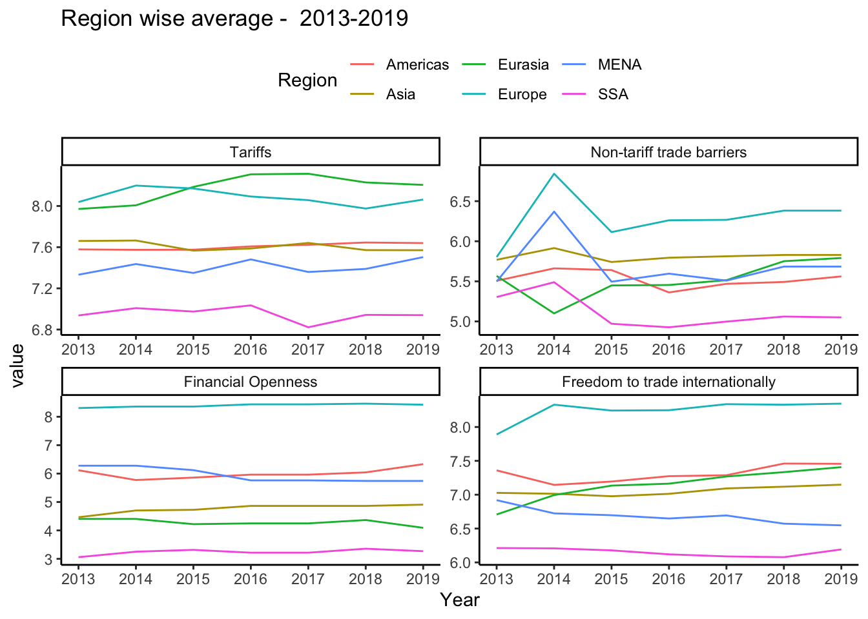
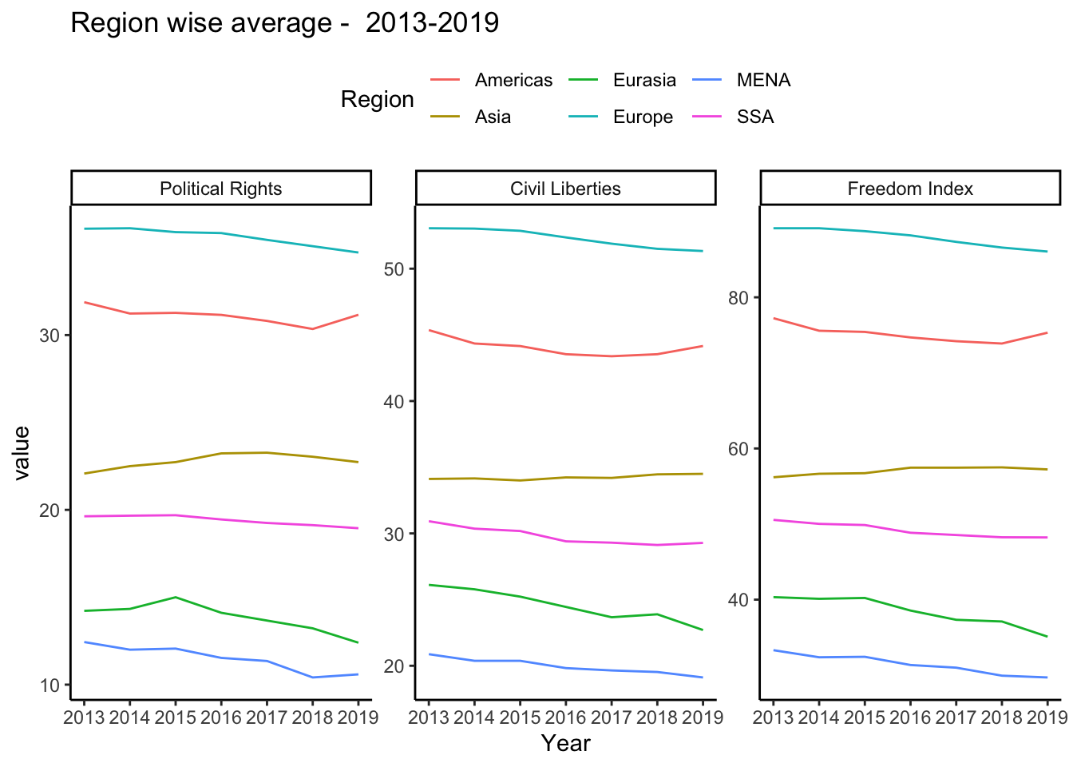
Graph

